Slide 1
Emerging Technologies
Matthew Crosby 10170652

Slide 2
What is emerging technology
Emerging technologies are new technologies that will change the status quo.
They are technologies that we can use now but also will be able to use in the future.
An example of this are phones that use both 3G and 4G, phones use both of these so in the past people using 3G could use the same phone for 4G when it was made widely available.

Slide 3
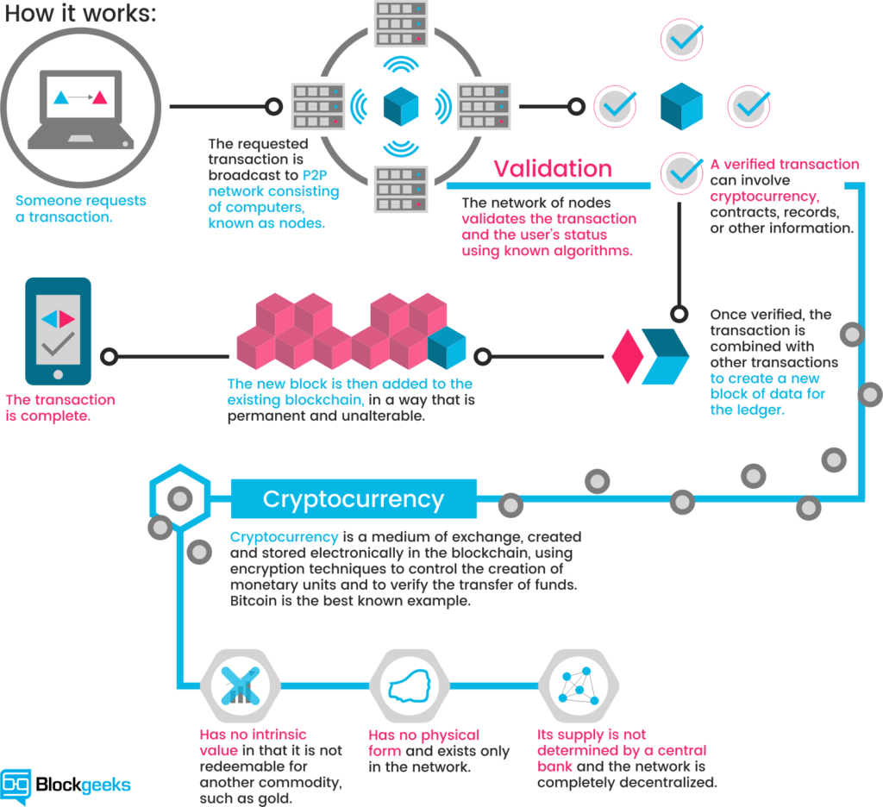
Cryptocurrency
Cryptocurrency is a digital currency that uses a encryption to regulate the generation of units.
An example of cryptocurrency is Bitcoin.
Bitcoin uses block chain technology which makes it almost impossible to forge fake transaction histories.
This is because any new block created has to be verified.
Notes:
Cryptocurrency is a digital currency that uses a encryption to regulate the generation of units. An example of cryptocurrency is Bitcoin. Bitcoin uses block chain technology which makes it almost impossible to forge fake transaction histories as each new block created has to be verified. The reason why cryptocurrency is an emerging technology is that it is used now but it will be widely used in the future due to its encryption and capability.
Cryptocurrency's are a recent trend in emerging technologies. Around 2012 Bitcoin was worth around £3 for a whole Bitcoin, now bitcoin is worth about £5000 with its peak being £14000 around a year ago. The way that cryptocurrencies work is to cut out the bank from the transaction. When someone wants to buy something then the shop will ask the bank whether that person has the money to afford the item, the bank will then check its records and if they do the bank will tell the shop that the person has the money and then will transfer the money. After the money has been transferred the bank will update its records and then take a fee. When taking the bank out the equation your records of how much money you have isn’t just in one place, such as the bank, instead it sends copies to many ledgers (records of financial accounts) all around the world so then when you want to buy something from a shop, the shop will ask all the record holders, which are computers not people, and once it has been confirmed the records are updated. This process helps in preventing any cheating or tampering of the records as there are many copies so out of the 1000s of copies, if one if different, it will be rejected.
There are many advantages and disadvantages to crypto currency, advantages include: Ease of use, this means that it is very easy to access your funds from anywhere without the need of providing several documents. Another advantage is the low cost of operation, this means that transferring crypto does not require a fee meaning unlimited transactions. One of the most important advantages is that it is very secure means that it is next to impossible for someone to make a payment on someone else's account.
Disadvantages include: not widely being available, only certain stores and websites accept crypto as in some countries crypto is illegal. Another disadvantage is not being able to reverse the payment is it was accidently made unless the receiver sends the money back. Finally another disadvantage is not being able to retrieve the coin if the password to the wallet is lost, this is because of how secure it is, if you lose the password there is no way to get back in.

Slide 4
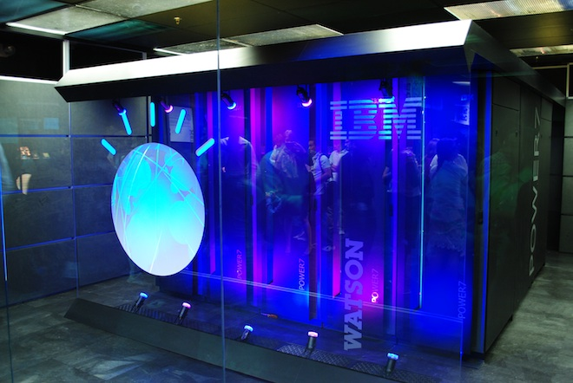

Artificial Intelligence
Artificial Intelligence is the development of a computer system to perform automated.
Artificial Intelligence has been around for many years but recently it is becoming more for home use.
AI has become more widely available and advanced in recent years.
Simple tasks e.g. shopping can be done through AI, an example being:
Amazon Alexa which can order products through voice commands.
Notes:
Artificial Intelligence is another type of upcoming technology as it has been used in the past but is now becoming more and more common as a role in our daily lives, changing the way we do things. An AI such as Amazon Alexa can do jobs which we can do making our lives easier such as turning lights on and off if they are Bluetooth/wifi, or even being able to shop for you, all as you would have to do is tell Alexa what you want and then the AI would purchase it and use the preferred delivery address and payment method. Another way AI is going to take over our lives is self-driving cars. These cars do exist but are not widely used just yet. On a Forbes article about AI in cars it explains about driverless cars, one thing it states is that driverless cars have been in a thought process for decades but only recently is being put into practice due to AI being more widely available and advanced. It states that cars should eventually be able to identify how other cars behave, the weather conditions, any road issues on the journey as well as many other factors that may contribute to the journey. This means that the AI will need to be able to understand human behaviour when driver, such as how they will act as with human drivers everyone has a different skill level so some people may make more mistakes when driving, this is one factor the AI will need to understand. The article also states that cars have many assisted features to reduce human error, such as a new Nissan car, in their advertisement which I saw on TV it demonstrated someone walking in front of the car and then the car analysing this and breaking. Another article on McKinsey also states about driverless cars as this is a big upcoming deal currently and will be more common around 2030. Another thing this article states is that AI won’t just affect how the vehicles will act and perform but also how they get built as sensors and devices will be connected to the Internet of Things. In 2016 Ai start us raised around $6 billion to fund them. With more time passing AI is getting more and more powerful as computer hardware is getting faster and able to perform more complex tasks. This article also proves that AI can be better than humans in certain ways as they are faster at doing thinking processes. If we think of all the information going through our brains as data to relate to the data that goes through an AI, we usually go through different ‘data’ before reaching the right process whilst an AI can calculate different routes, find the best one and be remembering what you have previously done to try and find a pattern to predict what will happen next. AI, such as Deep Blue, Watson and AlphaGo, has beat humans in different games such as chess, Jeopardy and Go.
The difference between these articles is that one states more about self-driving in automotive and the other states how AI will learn to do it.
A popular way AI that converges with our current technology is Alexa by Amazon, this AI can be on our phones through updates utilizing the features of the phone but also through a separate device such as Amazon Echo which connects through Bluetooth to your phone allowing you to connect the Amazon Echo to your home Wi-Fi, from here your Echo device can now control most if not every Wi-Fi enabled device in your home making it a true personal assistant. The way Echo works is it “connects to Alexa-a cloud-based voice service” and from here it can play music from any room with a Wi-Fi speaker, turn lights on and off (if Wi-Fi enabled) and from recent advertisements can search any information you desire such as recipes if you are cooking or how to spell a word.
Advantages of AI include: dealing with tasks that a person may not enjoy doing due to it being uninteresting for example. The way AI can achieve this is through automation to insure perfect precision and increase productivity. Due to AI being able to complete these boring tasks, people have the ability to perform the more creative tasks which would decrease negativity and increase enjoyment in the workplace. Another advantage of AI is that it can make extremely fast decisions and perform actions a lot faster than people. With people, we have a reaction time which to increase would take a lot of work, but the chance of getting the type of reaction speed that a computer can achieve is almost impossible and with hardware getting more and more powerful the speed of computers is constantly increasing. An example of this would be in factories where one smaller object will need to be inserted into a larger one to make a product, people would have to think about this, and their accuracy and reaction times would determine how fast this task can be completed. Whilst with an AI robot, these tasks can be completed at the same speed every time without mistake and at 100% accuracy. AI also has another advantage which is being able to aid humans by venturing to place we may not be able to, this could be due to space, toxicity and radioactivity.
Disadvantages of AI include: One of the main disadvantages with AI being the cost to create. The cost to create a powerful AI to be able to aid in maintaining a business will be very high as they are complex machine that need multiple algorithms to be able to function. Software is also another area that cost will be high as with AI changing and improving every day, the software assigned to it will need to be updated and maintained in order to be able to efficiently perform its job. As well as this, if the AI machine breaks down there will be a high maintenance cost to get the machine up and running again. For example, take hospitals, if a hospital system gets hacked like they have previously such as in May 2017, the AI systems may also get affected and instead of helping to keep people alive they could be hacked to do the opposite. Another disadvantage of AI is not being able to replicate humans, although this may be an advantage in a way, there are some disadvantages with not being able to achieve this yet. AI machines don’t feel any emotions, they don’t take morals into consideration, they simple do what they are programmed to do and if they do something different, they either perform incorrectly or break down. Not having the ability to be creative or have an imagination is another disadvantage of using AI as AI rely on facts and figures given to it. This is a simple disadvantage to some and may be classed as an advantage to not be able to express creativity. Now, one if the main disadvantages of AI is the unemployment of workers being replaced by AI as business owners may look at a job that can be done by a machine and chose to replace the person due to not having to pay a machine, this would save costs. Examples of this include Changying Precision Technology Company, this company used to employ over 650 people, now the factory is run by 60 machines that work 24/7 to perform the same job more efficiently. Only people that would need to maintain the robots and overlook what is happening in the company would actually still have a job.

Slide 5
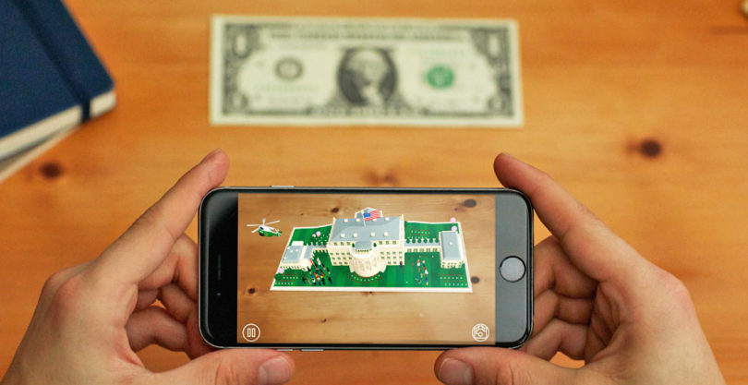
Augmented Reality
Due to better hardware augmented reality is becoming more popular.
AR can be used for many uses and come in many forms.
A common use is to display a model of some kind onto the screen through the camera using tracking technology.
The most common device AR are used on are mobile phones.
AR is not to be confused with VR (Virtual Reality) as VR doesn’t use the real world as a canvas.
Notes:
Augmented Reality has been around for a while but is recently becoming more popular due to devices having better hardware. AR can be used for many uses and come in many forms. A more common use is to display a model of some kind onto the screen through the camera using tracking technology to make sure that it seems through the screen that something is there. The most common device AR is used on is mobile phones. AR is not to be confused with VR (Virtual Reality) as VR doesn’t use the real world as a canvas.
Augmented Reality is a computer generated image that is displayed through a devices camera to give the idea of an item in the real world. The way this AI works is by using computer algorithms to analyse a cameras image. AR principles have been around for a long time, 1950s and 1060s is where they started to experiment with AR. Back then complex AR wasn’t viable as high end hardware to be able to run it was expensive but as smart phones are getting more advanced and more widely used AR is very common in apps such as Facebook Messenger and Snapchat. A few years ago an app called Pokémon Go was released which added the illusion through a phone screen that the virtual creatures were in the real world for the player to catch and collect. A problem AR is that it uses a lot of power to run smoothly and correctly so battery life on older devices can be very short using these apps. On other apps though such as the one in the image above, this app uses computer algorithms to analyse the dollar bill and display the white house onto of it. The difference between AR and VR is that VR creates an artificial environment.
Augmented reality has a few advantages to it, one being the ability to learn through AR, AR can help in schools by making the lessons more interactive and prompting participation between students. Another advantage of AR is navigation and tourism, this is by placing digital elements in the real world, examples of this are visuals on actual locations and map data such as markers and directions. Finally AR can be used in video games allowing for a richer human to computer relationship, like Pokémon go which is explained above.
Some disadvantages of AR include: privacy as AR is made up of data collected from its users, someone could hack into this and gather data about people. Another disadvantage is the requirements to implement, smaller companies may not have the resources to be able to fully utalise AR as AI is both technologically taxing and costly.

Slide 6

Implantable Drug Making Cells
Implantable drug making cells is a new upcoming technology that can save lives and change medicine as we see it.
These cells can make sure a person is getting the correct dose every time.
Previously the body would reject these cells so people would have to take immune supressing drugs.
Now they are sophisticated enough to not be rejected by the body.
This will replace current trends of having to take pills regularly.
Notes:
This new technology can save many lives as these cells could be used for treatment against long term diseases such as diabetes, cancer and cardiovascular disease. With diabetes for example many people have to prick their finger several times in one day in order to be able to measure the amount of blood sugar they have to be able to have the right dosage of insulin. By these people having islet cell implants injected this can eliminate the process of measuring blood sugar and manually injecting insulin. Islet cells are found in the pancreas and are not found in diabetics. Other implants that people can have include drugs that can help prevent heart failure, haemophilia and Parkinson's disease. The downside to these drug making cells is that people do have a high chance to still need immunosuppressant's forever to stop the immune system from attacking these cells, with these immunosuppressant's common diseases such as the common cold can be life threatening as the immune system will not fight off these common diseases. Recently scientists have created ways in with these cells are protected by semipermeable membranes that stop the immune system from attacking the cells, but if these membranes are identified by the body as foreign then the immune system will cause a layer of scar tissue to grow over the capsules preventing nutrients from reaching the cell therefore killing them.
This technology can replace the current trend of having to take pills regularly due to the process of the cell autonomously producing the drug needed in the correct dosage.
Advantages of this technology include being able to treat patients without the need of pills and injections due to the cells creating the drug, another advantages of this is that patients will always get the correct dosage so there is no risk of overdosing. A disadvantage of this however is the body rejecting the cells as they are foreign, patients will have to take immune suppressing drugs to prevent this, up until recently where the cells are more commonly being accepted by the body.

Slide 7
References
Blockgeeks.com. (2018). [online] Available at: https://blockgeeks.com/wp-content/uploads/2016/11/image-1-1024x936.png [Accessed 24 Oct. 2018].
Images-eu.ssl-images-amazon.com. (2018). [online] Available at: https://images-eu.ssl-images-amazon.com/images/I/51TFnR7AtGL._SY300_QL70_.jpg [Accessed 24 Oct. 2018].
L3apq3bncl82o596k2d1ydn1-wpengine.netdna-ssl.com. (2018). [online] Available at: https://l3apq3bncl82o596k2d1ydn1-wpengine.netdna-ssl.com/wp-content/uploads/2016/12/augmented-reality-white-house-810x417.jpg [Accessed 24 Oct. 2018].
Lee, S. (2018). Implantable Drug-Making Cells. [online] Scientific American. Available at: https://www.scientificamerican.com/article/implantable-drug-making-cells/ [Accessed 24 Oct. 2018].
WhatIs.com. (2018). What is augmented reality (AR)? - Definition from WhatIs.com. [online] Available at: https://whatis.techtarget.com/definition/augmented-reality-AR [Accessed 24 Oct. 2018].
Wired.com. (2018). [online] Available at: https://www.wired.com/images_blogs/wiredscience/2012/10/IBM_Watson.jpg [Accessed 24 Oct. 2018].
YouTube. (2018). Bitcoin explained: How do cryptocurrencies work? - BBC News. [online] Available at: https://www.youtube.com/watch?v=SzAuB2FG79A [Accessed 24 Oct. 2018].
Zappar. (2018). Zappar: What Is Augmented Reality (AR)? ?. [online] Available at: https://zappar.com/augmented-reality/ [Accessed 24 Oct. 2018].
Brian Rashid. 2018. How AI Pioneers Will Affect The Car Industry, And Why It's A Good Thing. [ONLINE] Available at: https://www.forbes.com/sites/brianrashid/2017/05/16/how-ai-pioneers-will-affect-the-car-industry-and-why-its-a-good-thing/#29d9ee7b57c2. [Accessed 18 October 2018].
McKinsey & Company. 2018. Building smarter cars with smarter factories: How AI will change the auto business | McKinsey . [ONLINE] Available at: https://www.mckinsey.com/business-functions/digital-mckinsey/our-insights/building-smarter-cars. [Accessed 18 October 2018].

